Slide 1
UNIQ+ Introduction to R Day 1
Merve Bilici
10 July 2025/Oxford

Slide 2
Course Overview
Thursday 10th July - R Fundamentals
Morning - Introduction to R
Session 1.1 - 9:30-10:15 - R & RStudio
Session 1.2 - 10:20-11:00 - Data structures
Tea/Coffee - 11:00-11:15
Session 1.3 - 11:15-12:30 - Conditionals & Loops
Lunch - 12:30-13:30
Afternoon - Exploring data
Session 1.4 - 13:30-14:30 – I/O, tabular data, plotting basics
Session 1.5 - 14:45-15:30 – Matrices & more plotting
Session 1.6 - 15:45-16:30 – Choose your own adventure
Friday 11th July - Into the Tidyverse
Morning - Advanced plotting and data wrangling
Session 2.1 - 9:30-10:15 – Packages & ggplot2
Session 2.2 - 10:20-11:00 – tidyverse basics
Tea/Coffee - 11:00-11:15
Session 2.3 - 11:15-12:30 – Reshaping data
Lunch - 12:30-13:30
Afternoon - Reproducible research
Session 2.4 - 13:30-14:30 – Rprojects, paths, RMarkdown
Session 2.5 - 14:45-15:30 – Exploratory data analysis Session 2.6 - 14:45-15:30 – More Exploratory data analysis

Slide 3
Today’s Session:
Introduction to R & Exploring data

Slide 4
R and RStudio Installation Troubleshooting - 9:00-9:30
Session 1.1 - 9:30-10:15
Introductions
Course Structure, Goals
Intro to R and RStudio
Demo - Getting Started
R as a calculator
Objects & Functions
Finding help
Exercise
Session 1.2 - 10:20-11:00
Data types ​(numeric, character, factor)
Data structures (atomic vectors, data frames, lists, matrices)
Arithmetic with data structures
Subsetting, filtering, reordering
Exercise
Tea/Coffee Break 11:00-11:15
Session 1.3 - 11:15-12:30
Conditionals
Loops: for, while
Custom functions
Exercise
Lunch - 12:30-13:30
Afternoon - Exploring data
Session 1.4 - 13:30-14:00
Importing data
Tabular data
Missing values
Summary statistics
Exercise
Session 1.5 - 14:15-15:30
Plotting with base R
More plotting with base R
Exercise
Session 1.6 - 15:45-16:30
Choose your own adventure
Exercise

Slide 5

Session 1.1
Why R?
R is a statistical programming language. Originally there was a commercial programming language called S (for statistics) and some statisticians decided to make a free equivalent called R – which became so popular S went bust.
R allows users to do sums and make plots via code – which is great because code is reusable and easy to follow. As well R:
Can handle small or extremely large datasets easily
Data to be loaded manipulated and saved to disk
Allows loops and logical functions.
Allows plots to be generated and made to look pretty
Has an extensive network of users to contribute new functions (libraries)
Code can be reused for new projects, which is highly time efficient
Less prone to human error than excel, graph pad and prism

Slide 6
Getting started
Session 1.1
R is the language – can be run at the console (no frills) or in an Integrated Development Environment (IDE) (a fancy user interface with a lot of convenience features)
RStudio is an IDE
Printing text and numbers
A fancy calculator
Add comments in code to explain what you are doing
What is a function?
Imagine it as a tool that can help you perform an action
it (may) take an input within the parentheses and give an output
Typically function_name(argument1, argument2,…)
Everything in R is a function (even if doesn’t look like it)

Slide 7
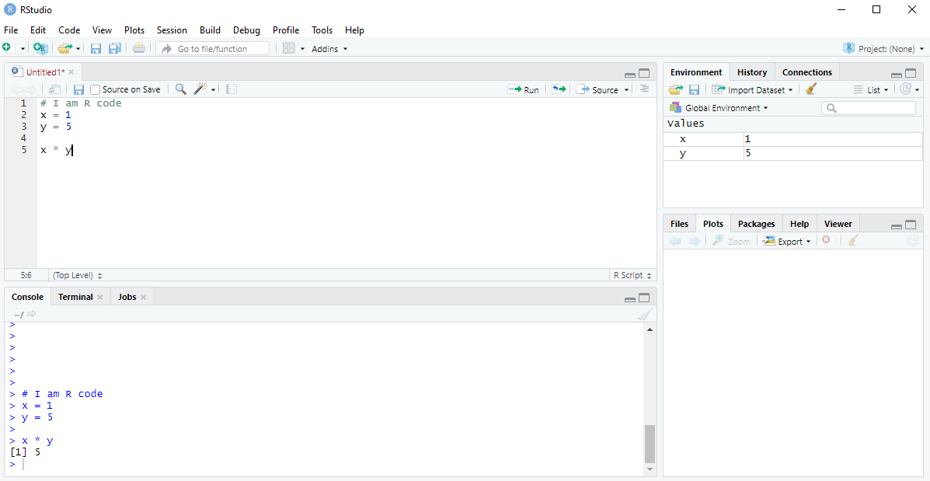
Session 1.1
What is R studio?
R studio is the most popular platform for running R in. Normally for reasons best not understood R runs from the command line. Which is almost unusable. To make things easier to use R studio provides a nice user interface with many excellent features. R studio is free to download and suitable for any operating system.

Slide 8
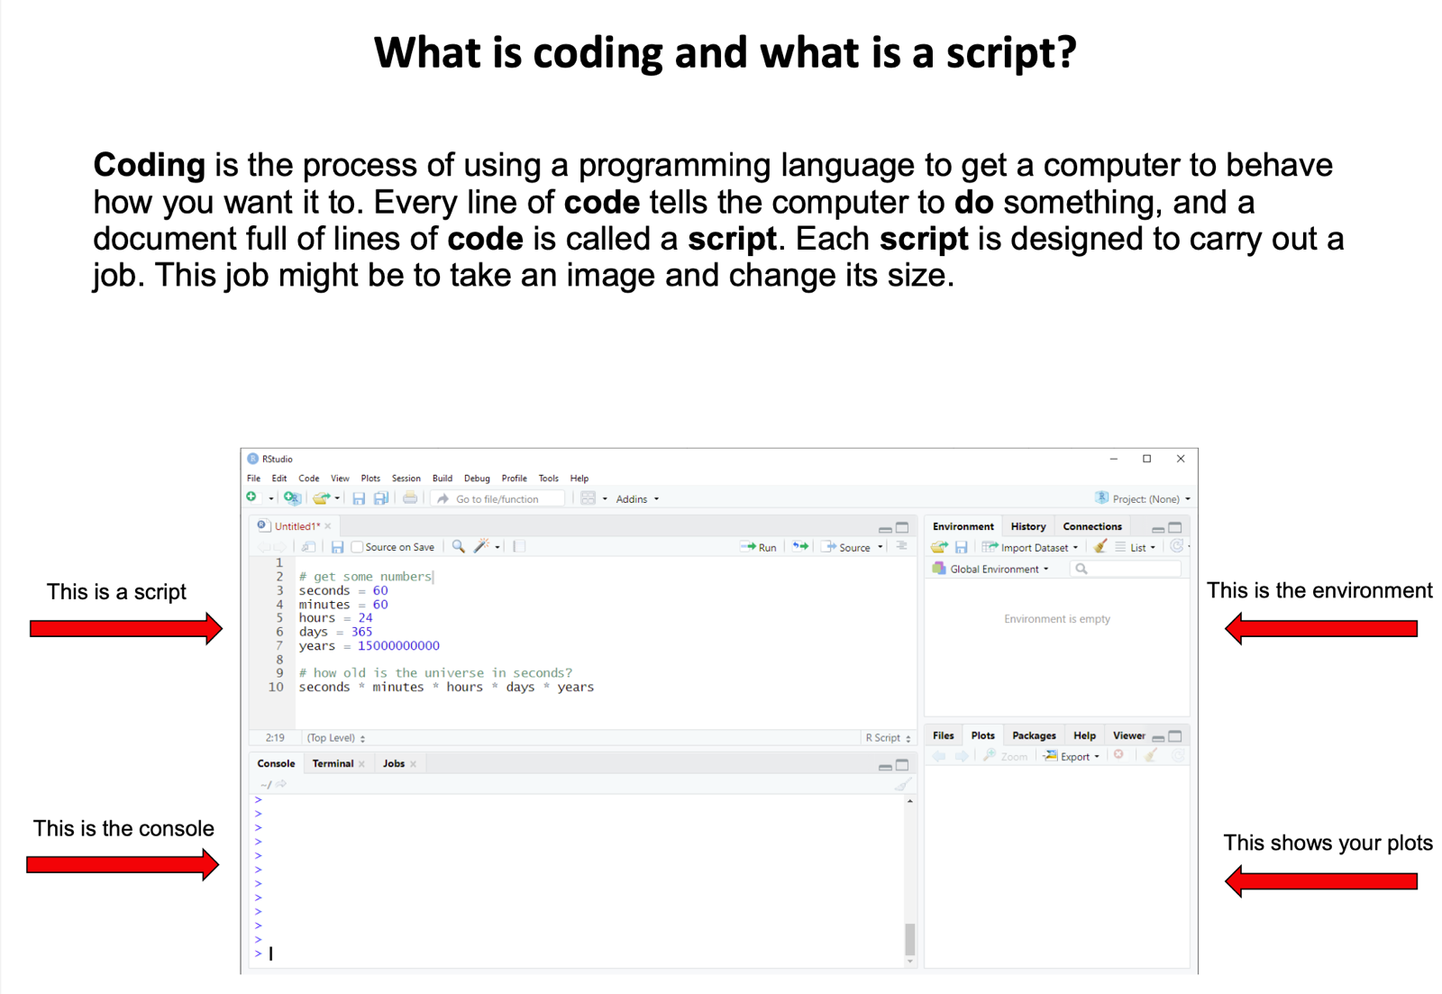

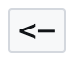
Session 1.1
Assignment operator
OR

Slide 9
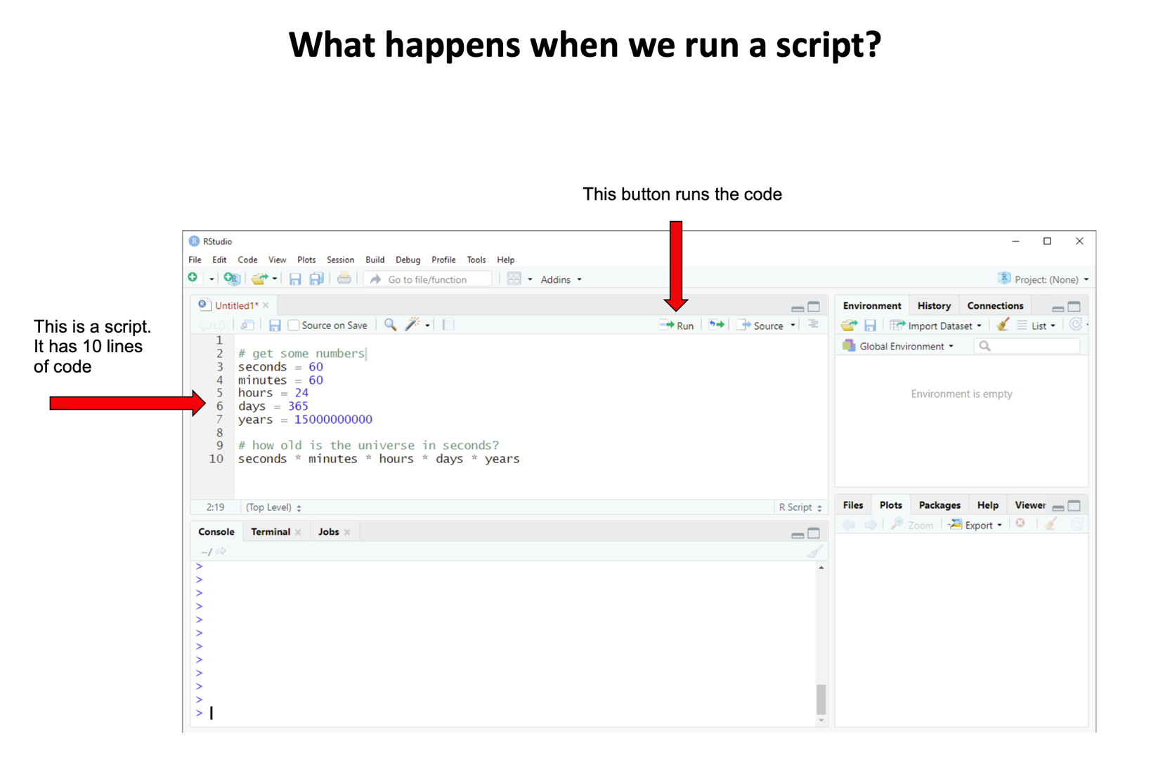
Session 1.1

Slide 10
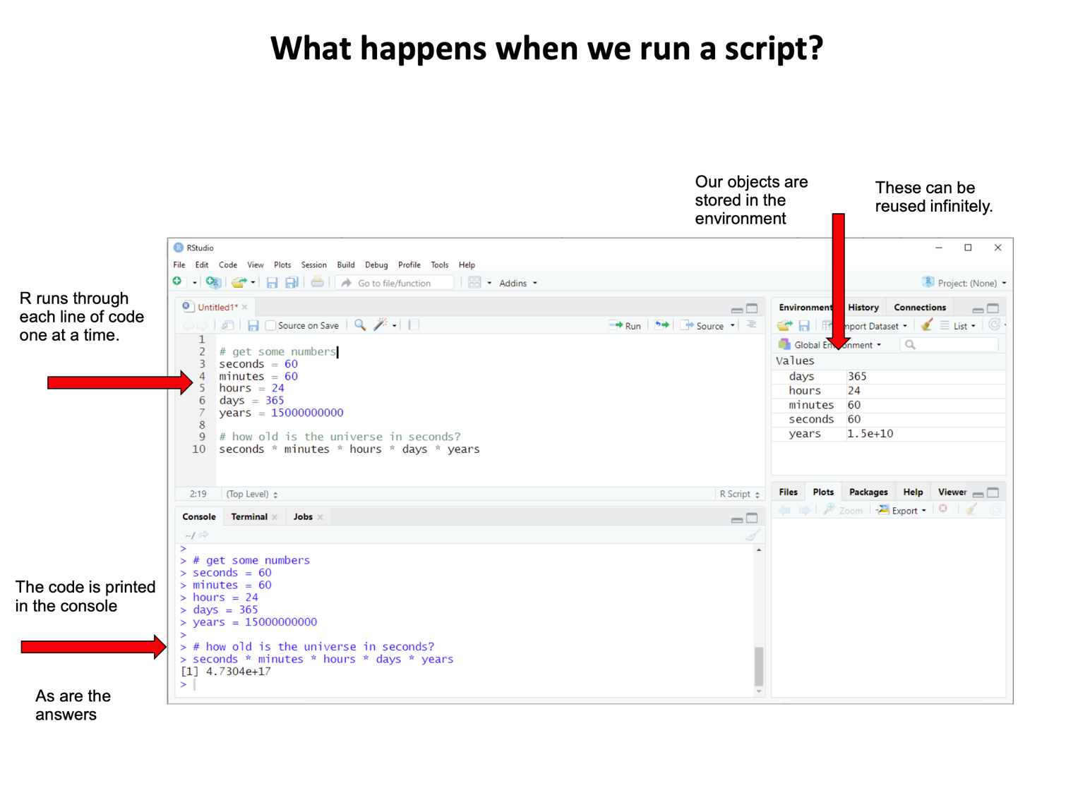
Session 1.1

Slide 11
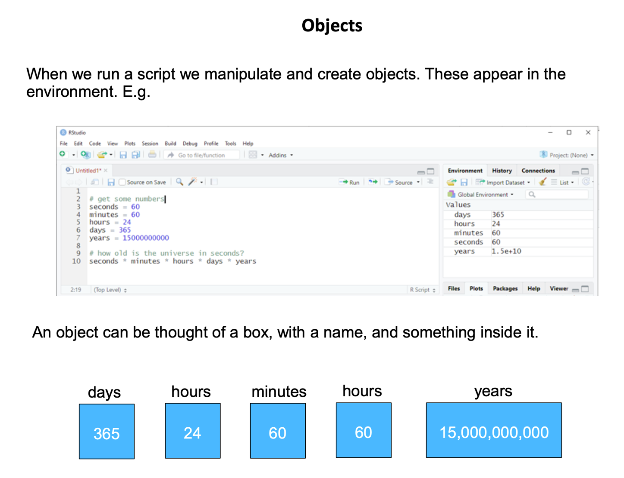
Session 1.1

Slide 12
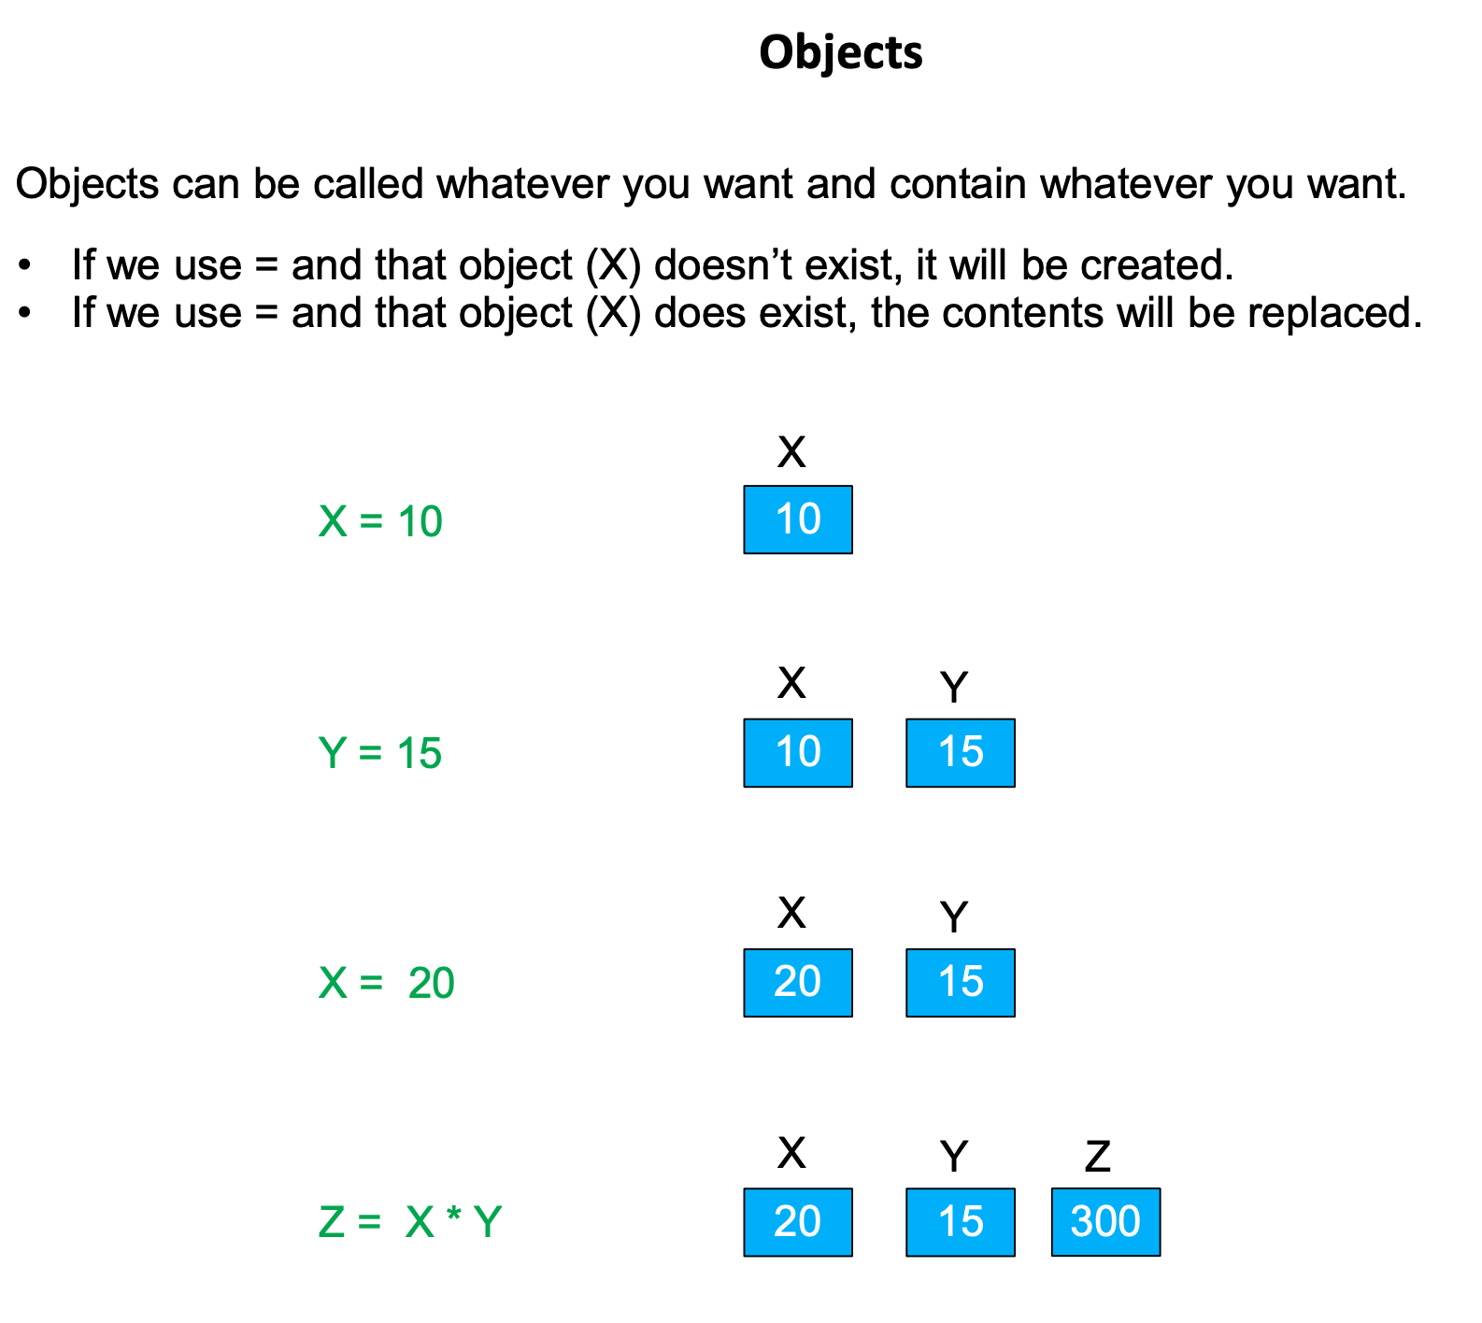
Session 1.1

Slide 13
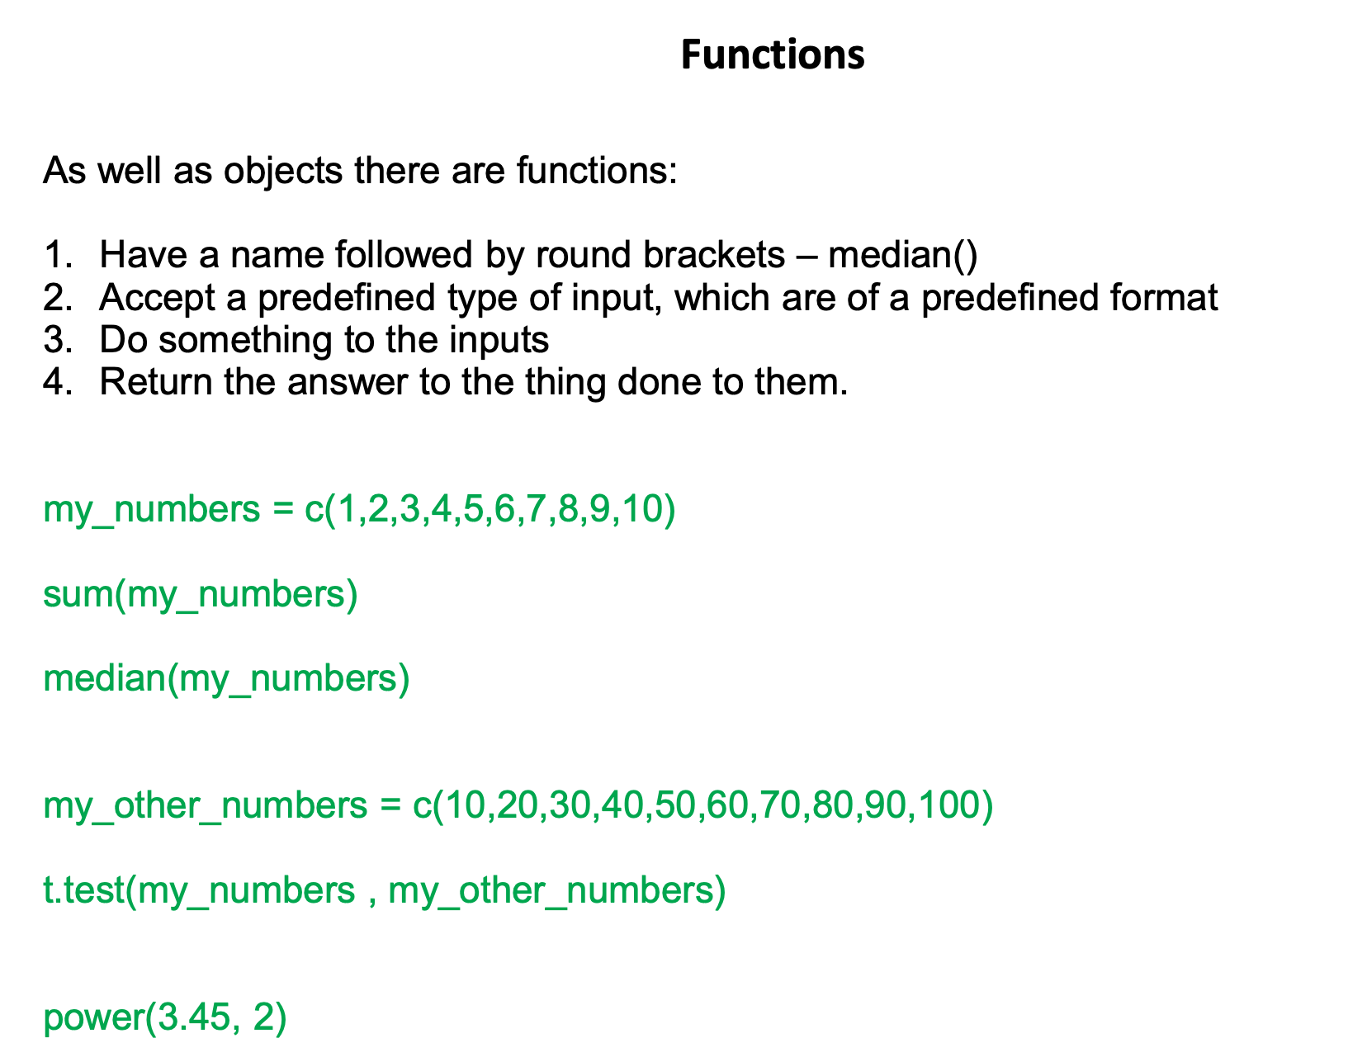
Session 1.1

Slide 14
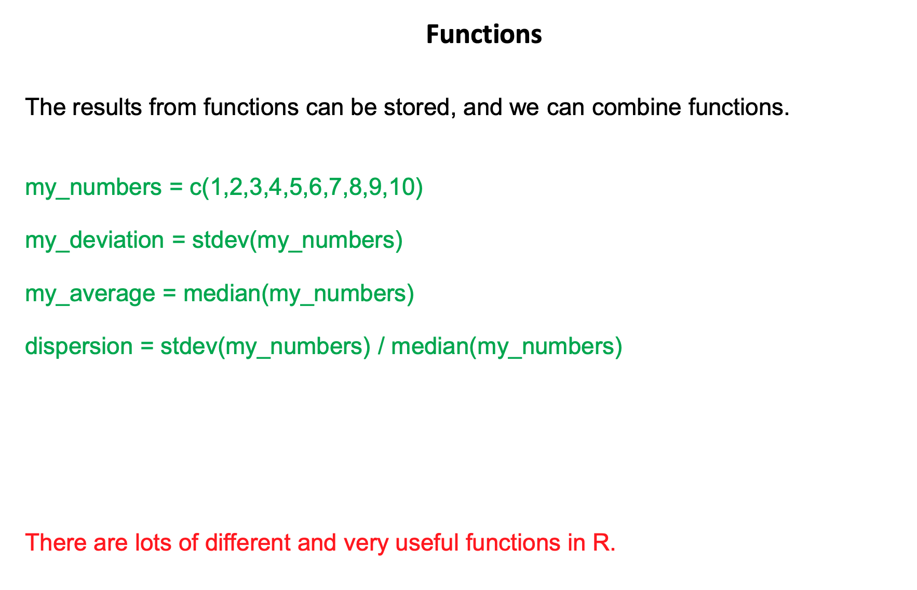
Session 1.1

Slide 15
Getting help in R
Session 1.1
The help() function
You can also use ?
Use the search box in help tab in RStudio
General concepts
Books such as R for Data Science (Roger Peng), book by Hadley Wickham
Websites such as tidyverse.org
Specific tasks
StackOverflow (ranked questions and answers)
Cheatsheets

Slide 16
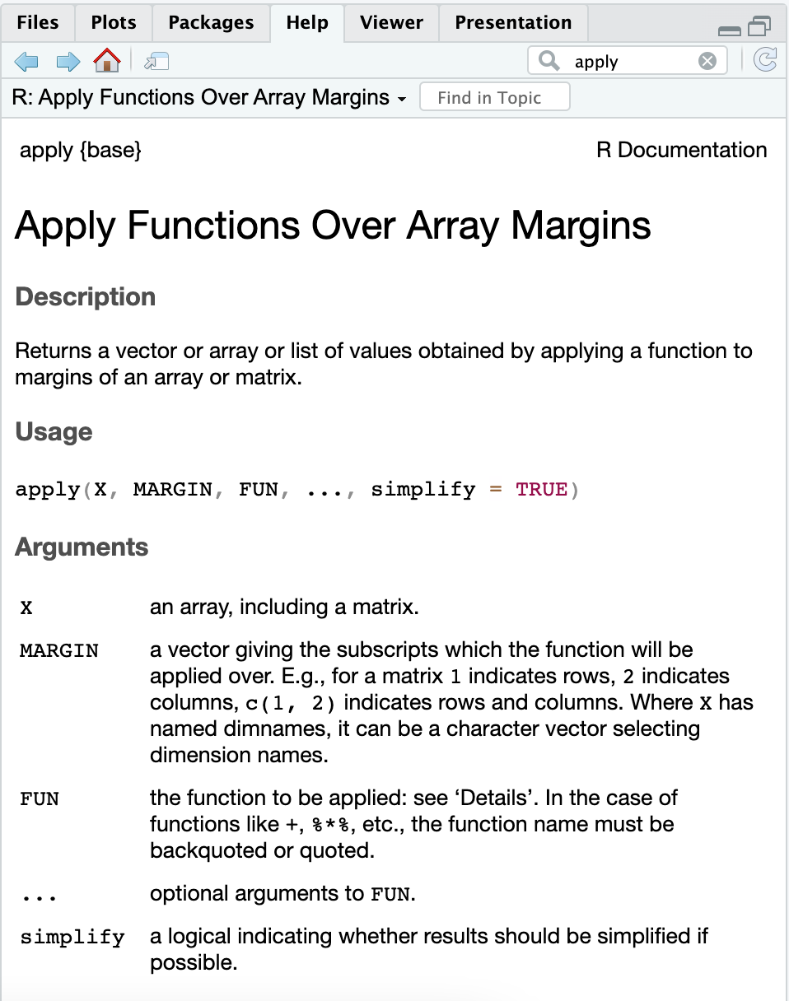
Session 1.1
?apply()

Slide 17
Errors and warnings
Session 1.1
Error
R stops execution
The error message gives you a clue as to what went wrong
traceback() helps you figure out where it went wrong
Warning
R continues execution of the rest of the code
Still important to pay attention to warnings
warnings() lists the most recent warnings
Copy-paste error or warning messages into Google search

Slide 18

Getting started exercise
Image by lucabravo on Freepik

Slide 19
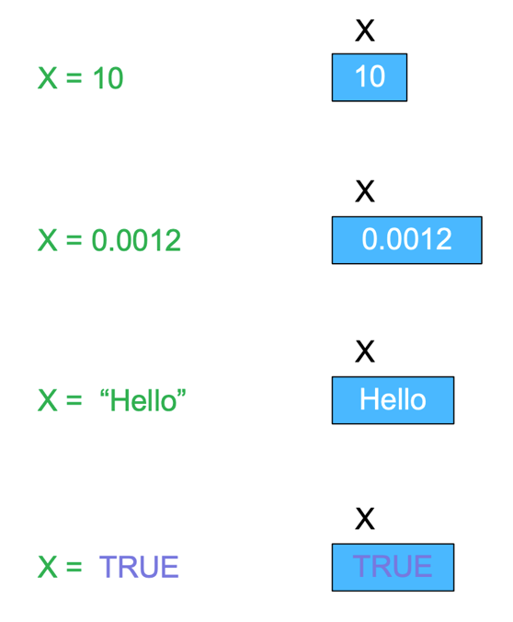
Session 1.2
Data types ​
Numeric (1, 2, 1.1, 2.3 etc.)
Character (‘a’, ‘apple’, “truck”)
Logical (TRUE, FALSE)
Factor (1:control, 2:drug treatment)
How to find out data type of an object
str()
class()

Slide 20
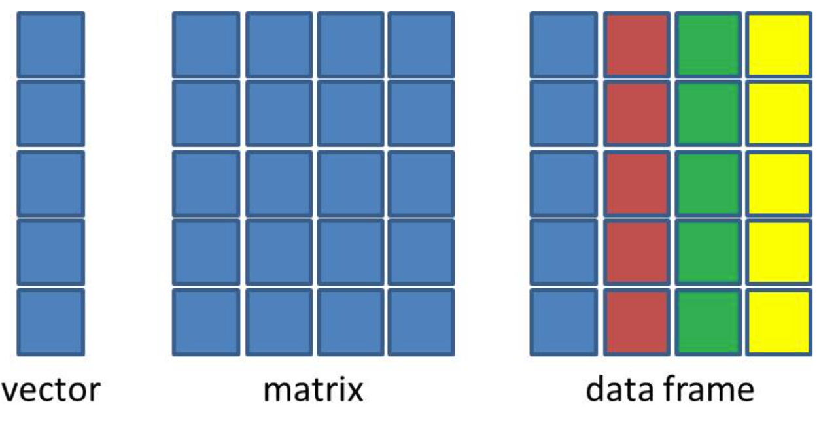
Session 1.2
Data structures
One dimensional data
X= c(1,2,3)
Two dimensional data (matrices and data frames)

Slide 21
Data structures
Session 1.2
atomic vector
list
data.frame
matrix
How to find out data structure of an object
str()

Slide 22
Data structures – atomic vector
Session 1.2
One dimensional
All elements are of the same type (e.g. all character or all numeric)
Constructors
c()
:
Subset using []
Number of elements can be obtained using length()
a
c
p
z
1
2
3
4

Slide 23
Data structures – list
Session 1.2
[1]
a
c
p
z
The most flexible data structure
Can mix different data types and different data structures (atomic vector, data.frame, matrix, even another list!)
Constructor: list()
Subset using [ ] and [[ ]]
[2]
[[2]]
1
2
3
4
[2]
28
23
13
1
2
3
[3]
T
F
T
T
T
1
2
3
4
5
[2]
28
23
13
1
2
3
28
23
13
1
2
3

Slide 24
Data structures – data.frame
Session 1.2
Rows
It is a special case of a list where:
all elements are atomic vectors
all elements are of the same length
Constructor: data.frame()
Subsetting with [ ], [[ ]], $
Columns
[1]
a
c
p
z
1
2
3
4
[2]
28
23
13
6
1
2
3
4
Columns
T
F
T
T
Rows
[1]
[2]
[3]
[3]
a
28
T
1
2
3
4
1
2
c
23
F
3
p
13
T
4
z
6
T

Slide 25
Data structures – matrix
Session 1.2
An atomic vector with 2 dimensions
Can be thought of as a special case of the data.frame where:
All elements of all columns are of the same type
(Not entirely accurate, but easier to remember it like this!)
Constructor: matrix()
Subsetting with [ ]
Columns
Rows
[1]
[2]
[3]
a
28
T
1
2
c
23
F
3
p
13
T
4
z
6
T

Slide 26
Overview of the dataset
Session 1.2
Viewing the dataset itself
View()
head()
tail()
Information about the dataset
dim()
nrow() and ncol()
Summary of the data
summary()

Slide 27

Subsetting
Session 1.2
Square brackets [] – subsetting
Subsetting can be done with
Indices (integer numbers)
Row/column names
data.frame subsetting
df[row_index, column_index]
df[“row_name”, “column_name”]
df[start_index:end_index, start_index:end_index]
df[c(row_indexes or row_names), c(col_indexes or col_names)]
df$column_name

Slide 28
Filtering
Session 1.2
Filtering is subsetting based on specific conditions
Using the subsetting notation [ ]
data.frame filtering
df[df$column == “Gray”, ]

Slide 29
Data structures exercise
Image by lucabravo on Freepik

Slide 30

Break Time

Slide 31
CONDITIONALS

Slide 32
Conditionals:
Session 1.3
Useful when you do not want to execute one statement after another but to have control over the flow of execution also.
Determine if a specified condition is met (or not) then direct subsequent analysis or action depending on the result
There are basic conditionals and syntax in R
if → if (condition) statement
If…else → if (condition) statement 1 else statement 2
ifelse → ifelse (condition, yes, no)

Slide 33
Conditionals: if statements
Session 1.3
If produces a logical value from the condition and carries out the next statement only when the value becomes TRUE.
If statements are a Boolean expression followed by a single or multiple statements.
Condition: any expression that evaluates TRUE or FALSE.
if (condition) {
do something
}
x = 6
if (x > 4) {
print(“Number higher than 4”)
}
?
x > 4
condition
TRUE
print(“Number higher than 4”)
statement
Number higher than 4

Slide 34
Conditionals: if…else statements
Session 1.3
If statements are followed by an optional ”else” statement that gets executed when the Boolean expression becomes false.
if (condition) {
do something if condition is true, this happens (TRUE branch)
} else {
do something else if condition is false, this happens (FALSE branch)
}
x = 6
if (x > 8) {
print(“Number higher than 8”)
}else{
print(“Number lower than 8”)
}
?
x > 8
condition
FALSE
TRUE
print(“Number lower than 8”)
print(“Number higher than 8”)
statement B
statement A
else block (FALSE BRANCH)
If block (TRUE BRANCH)

Slide 35
Conditionals: chained conditionals (else if)
Session 1.3
if (condition A is TRUE) {
do something (statement A)
} else if (condition B is TRUE) {
do something else (statement B)
} else {
do something else (statement C)
}
x = 0
if (x > 0) {
print(“Positive number”)
}else if (x < 0){
print(“Negative number”)
} else {
print(“Zero”)
}
If first condition is true, statement A is executed
New condition to test if previous one was false
False branch.
Executed if none of the conditions above are true

Slide 36
Conditionals: chained conditionals (else if)
Session 1.3
if (condition A is TRUE) {
do something (statement A)
} else if (condition B is TRUE) {
do something else (statement B)
} else {
do something else (statement C)
}
x = 0
if (x > 0) {
print(“Positive number”)
}else if (x < 0){
print(“Negative number”)
} else {
print(“Zero”)
}
Condition A
TRUE
statement A
FALSE
Condition B
TRUE
statement B
FALSE
statement C

Slide 37
Conditionals: ifelse() function
Session 1.3
Conditional statements are not vector operations, they deal only with a single value.
If we pass the if statement to a vector it will generate a warning.
ifelse() function checks the condition for every element of a vector and selects elements from the specified vector depending upon the result
Syntax:
ifelse(condition, TrueBranch, FalseBranch)

Slide 38
LOOPS
Session 1.3

Slide 39
Loops
Session 1.3
Programming instruction that repeats a chunk of code until a specific condition is reached. The loop executes a code block again and again until no further action is required.
Iteration: repetition of a process. Each time the code block within the code is executed is called iteration.
Loops are great tools to play around with code and gain a deeper understanding of R.
We will see for loops and while loops

Slide 40
Loops: for-loops
Session 1.3
Used to iterate over a sequence.
Perform same action for each item in a list of things.
Syntax:
for (val in sequence)
{
statement
}
Where the sequence can be a vector or a list and val takes a different value each time during the loop. The same statement is evaluated in every iteration.

Slide 41
Loops: for-loops
Session 1.3
genes = c(“PI3K”, “FOXO”, “VLDL”, ”LIPC”)
for (val in genes)
{
print(val)
}
[1] "PI3K”
[1] "FOXO"
[1] "VLDL"
[1] "LIPC"

Slide 42
Loops: while-loops
Session 1.3
Used to iterate indefinitely as long as certain logical condition is TRUE.
It is called condition-controlled loop.
Syntax:
while (condition)
{
statement
}
Loop body. Executed as long as condition is TRUE

Slide 43
Loops: while-loops
Session 1.3
x = 0
while (x < 10)
{
x = x + 1
print (x)
}
[1] 1
[1] 2
[1] 3
[1] 4
[1] 5
[1] 6
[1] 7
[1] 8
[1] 9
[1] 10
condition
FALSE
TRUE
statement
Exit loop

Slide 44
Let´s practice!
Session 1.3
Conditionals and loops exercise
Image by lucabravo on Freepik

Slide 45
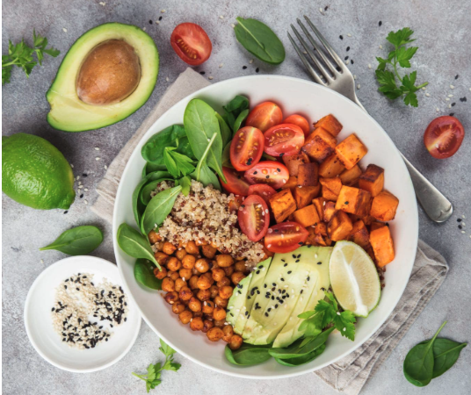
Break Time

Slide 46
Importing data
Session 1.4
Functions to read data
read.table()
read.csv()
You have to tell the function where the file is – the ‘path’
Working directory – e.g. 1-4 Keble Rd, Oxford OX1 3NP, United Kingdom
Absolute path – e.g. Natural History Museum, Parks Rd, Oxford OX1 3PW, United Kingdom
Relative path (makes no sense unless you know what your working directory– e.g. go up the street, turn right, the building towards your left
Print the current working directory getwd()
Change the current working directory setwd()

Slide 47
Tabular data in R
Session 1.4
The data.frame is like a spreadsheet
Rows (with row names and indices)
Columns (with column names and indices)
What’s an index? – a serial number starting from 1
data.frames are made of building blocks called atomic vectors
Each column has to be of the same ‘type’ – numeric / character / logical / factor

Slide 48
Basic statistics
Session 1.4

Slide 49
Basic statistics
Session 1.4
Correlation – relationship between two continuous variables
cor.test()
Comparison of means
t.test()
wilcox.test()
Random sampling
rnorm()
sample()
set.seed()

Slide 50
Let´s practice!
Session 1.4
Importing data and basic stats
Image by lucabravo on Freepik

Slide 51
HANDLING MISSING VALUES
Session 1.4

Slide 52
NA/NaN
Session 1.4
NA/NaN are used to define missing values.
This happen when there is no data or insensible or impossible arithmetic operations are tried.
Finding/test missing data: is.na()/is.nan()
Filtering missing data:
na.omit()- rules out any rows containing missing value
Careful! Sometimes missing data comes in other forms as “-” , 0 or “not specified”. These probably need recoding.

Slide 53
Let´s practice!
Session 1.4
Missing values exercise
Image by lucabravo on Freepik

Slide 54
DATA VISUALISATION
Session 1.5

Slide 55
Plotting with R
Session 1.5
Easy to visualise data
What do we want to visualize?:
Do we need detailed info (see every data point) or just mean/median or distribution?
What type of data we have?
Scale?
Colours?
Legend?
Important to understand basic concepts (e.g., how to call variables of df)

Slide 56
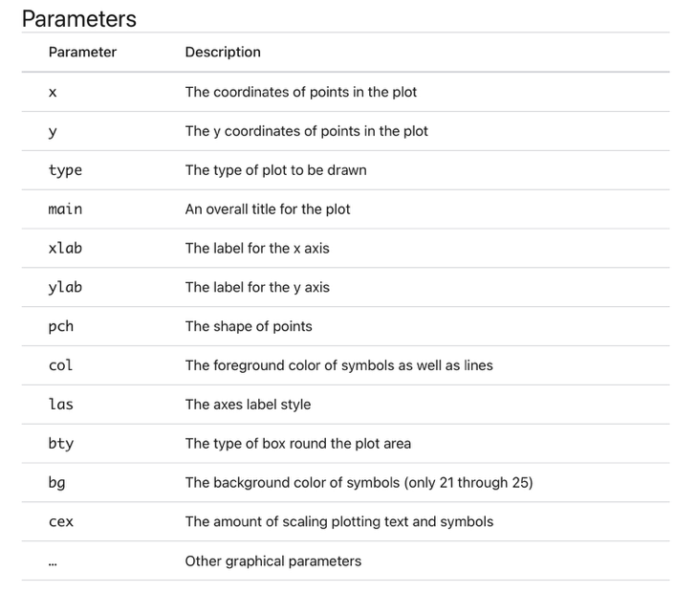
Basic R plotting
Session 1.5
Function plot() is not a single defined function. Generic function. The exact function being called will depend on the parameters used.

Slide 57
Basic R plotting
Session 1.5
Type of graph | Command
Histogram | hist()
Boxplot | boxplot()
Scatterplot | plot()
Pairwise correlation | pairs()
Arguments matter…
Arguments | Plot
plot(x,y) | Scatterplot of x and y numeric vectors
plot(factor) | Barplot of the factor
plot(factor,y) | Boxplot of the numeric vector and the levels of the factor
plot(df) | Correlation plot of all dataframe columns

Slide 58
Categorical data / factors
Session 1.5
Data that can be separated into categories. e.g., race, sex or educational level.
We can convert data using as.factor().

Slide 59
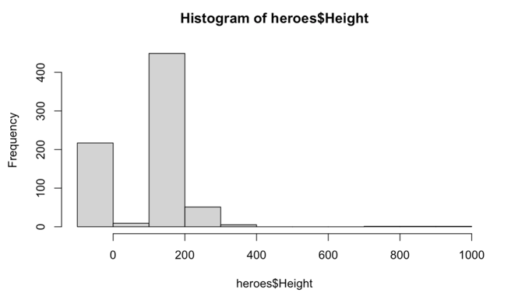
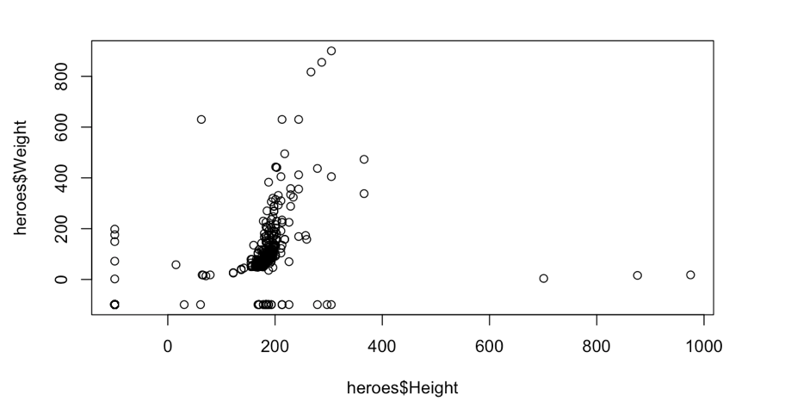
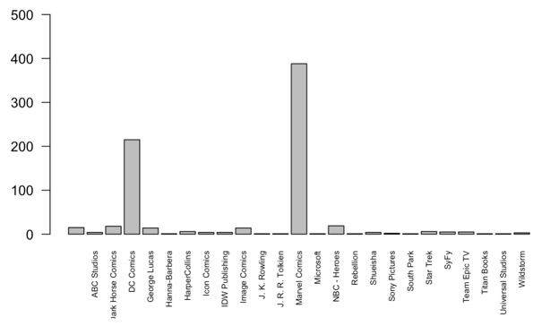
Basic R plotting
Session 1.5
hist(heroes$Height)
plot(heroes$Height, heroes$Weight)
plot(heroes$Publisher)

Slide 60
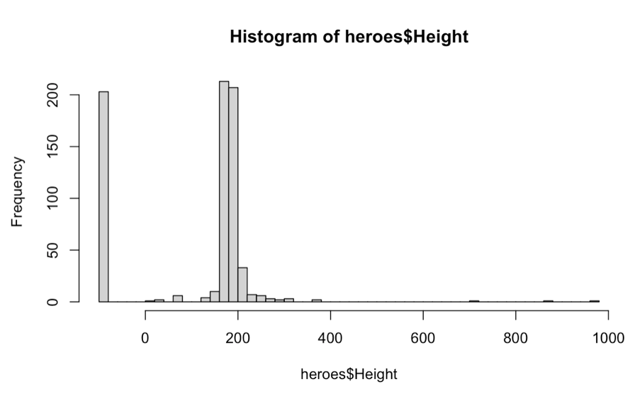
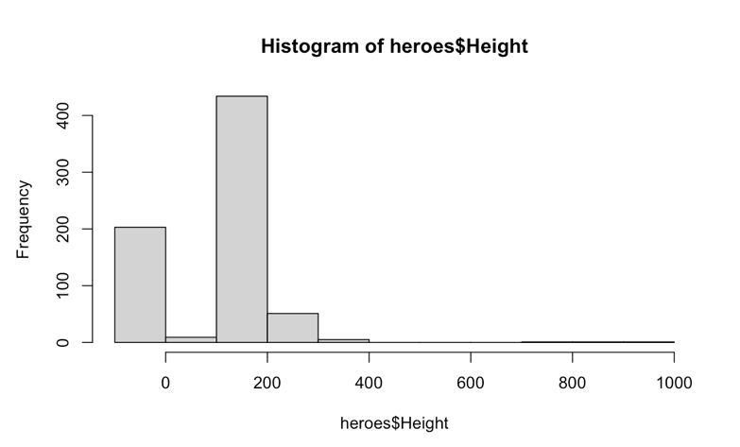
Basic R plotting: histogram
Session 1.5
hist(heroes$Height)
hist(heroes$Height, breaks=50)

Slide 61
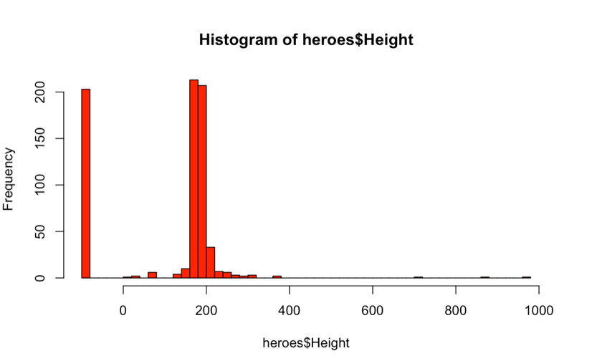
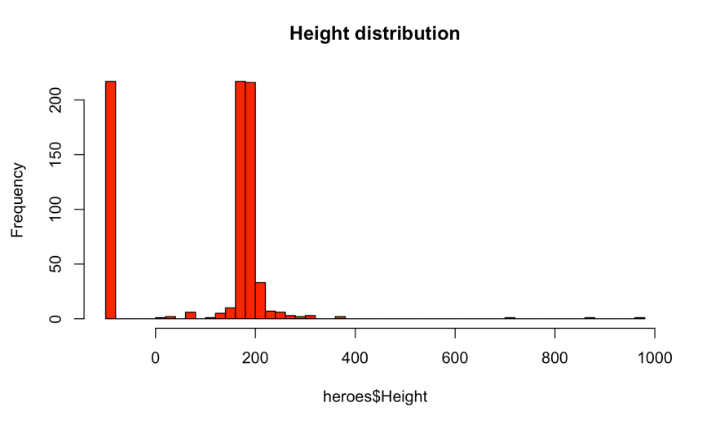
Basic R plotting: histogram
Session 1.5
hist(heroes$Height, breaks=50, col= “red”)
hist(heroes$Height, breaks=50, col= “red”, main = ”Height distribution”)

Slide 62
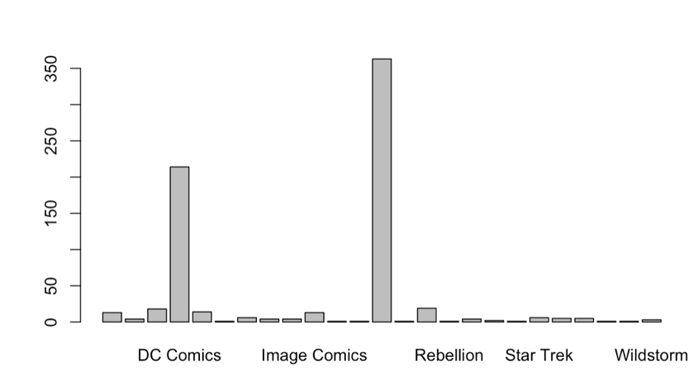
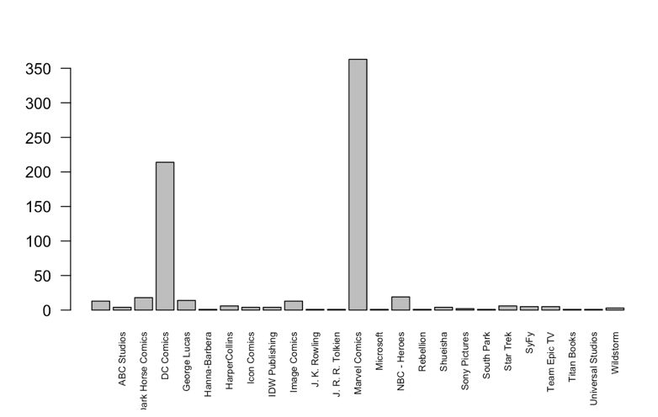
Basic R plotting: barplots
Session 1.5
plot(heroes$Publisher)
plot(heroes$Publisher, las=2)

Slide 63
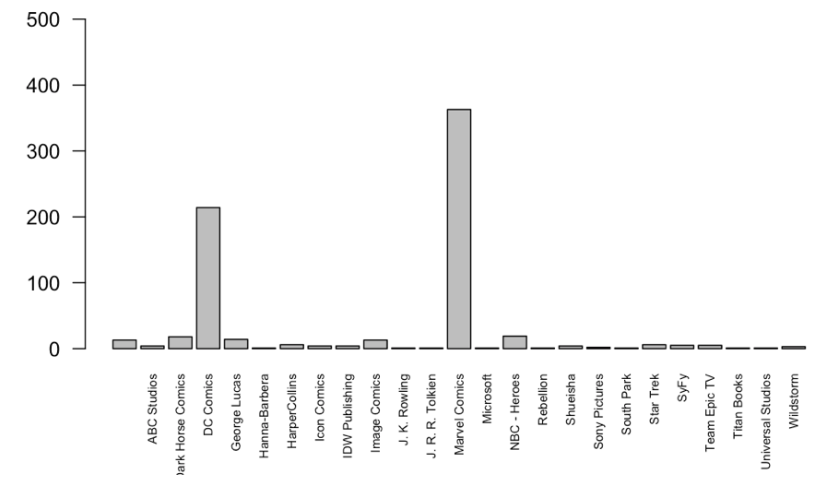
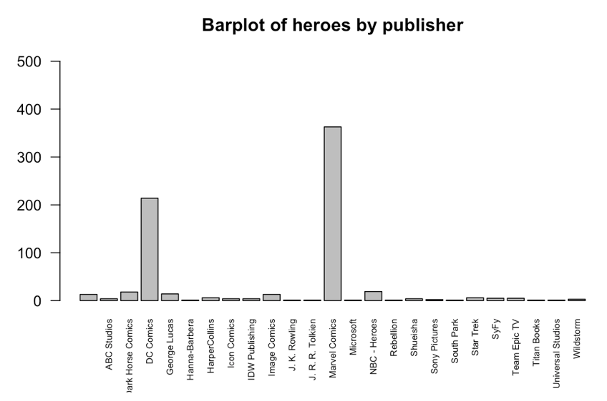
Basic R plotting: barplots
Session 1.5
plot(heroes$Publisher, las=2, ylim= = c(0,500))
plot(heroes$Publisher, las=2, ylim= c(0,500), main = "Barplot of heroes by publisher")
TAKE HOME MESSAGE:
YOU NEED TO KNOW ALL YOU CAN DO BUT YOU DON´T NEED TO KNOW ALL

Slide 64
Basic R plotting: scatterplot
Session 1.5
plot(heroes$Height, heroes$Weight)

Slide 65
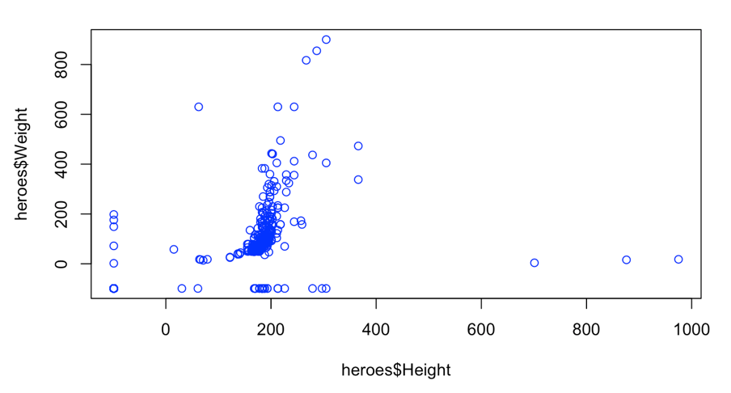
Basic R plotting: scatterplot
Session 1.5
plot(heroes$Height, heroes$Weight, col=“blue”)

Slide 66
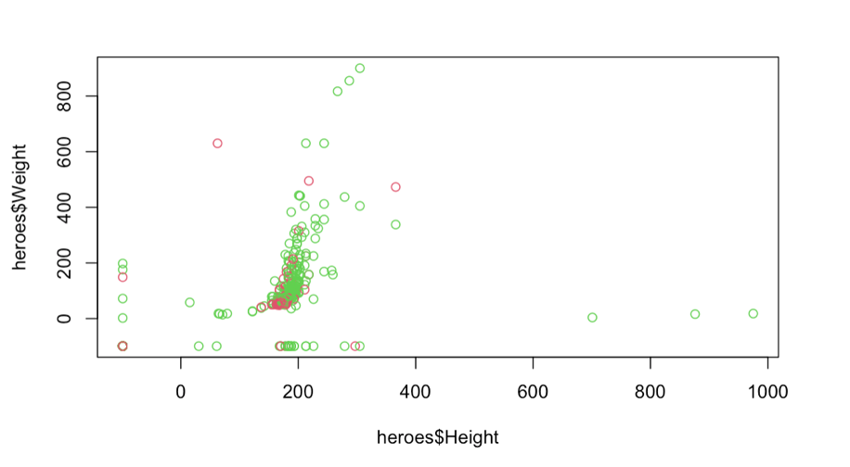
Basic R plotting: scatterplot
Session 1.5
plot(heroes$Height, heroes$Weight, col=heroes$Gender)

Slide 67
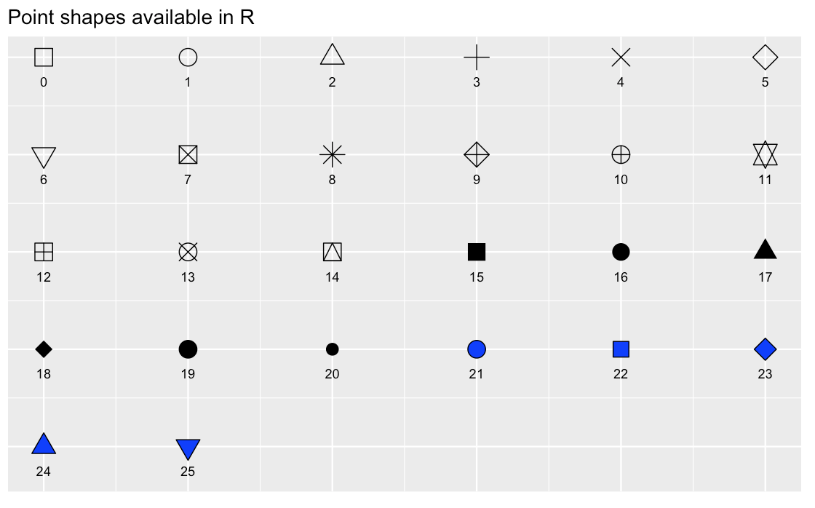
Basic R plotting: scatterplot
Session 1.5
plot(x,y)
plot(x,y
xlab =(), #x title
ylab =(), #y title
xlim = c(), #x axis
ylim = c(), #y axis
pch = (), #plotting symbol
las =()#axis label angle
cex.axis =() #axis label magnification/reduction
)

Slide 68
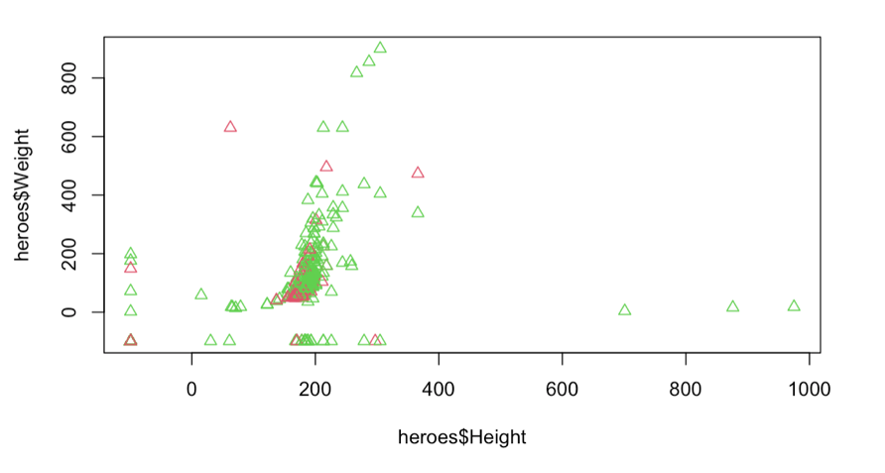
Basic R plotting: scatterplot
Session 1.5
plot(heroes$Height, heroes$Weight, col=heroes$Gender, pch=24)

Slide 69
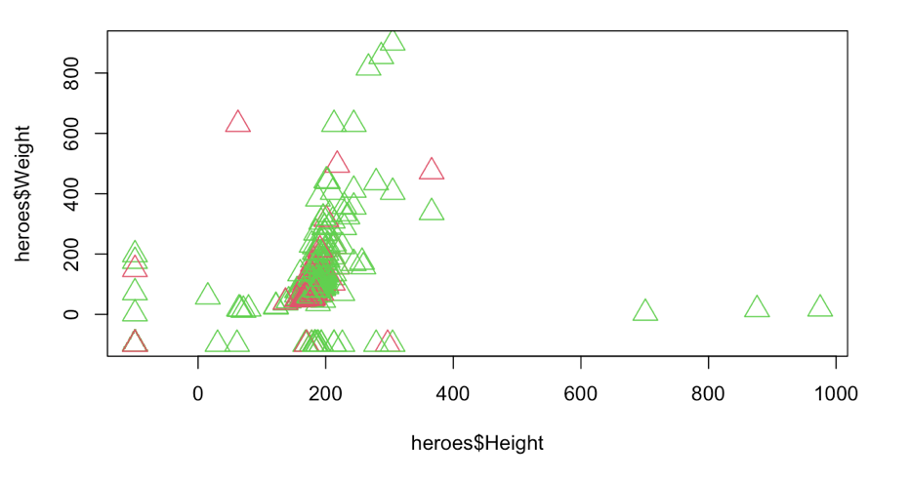
Basic R plotting: scatterplot
Session 1.5
plot(heroes$Height, heroes$Weight, col=heroes$Gender, pch=24, cex=2)

Slide 70
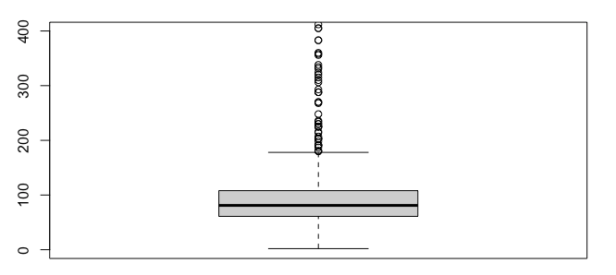
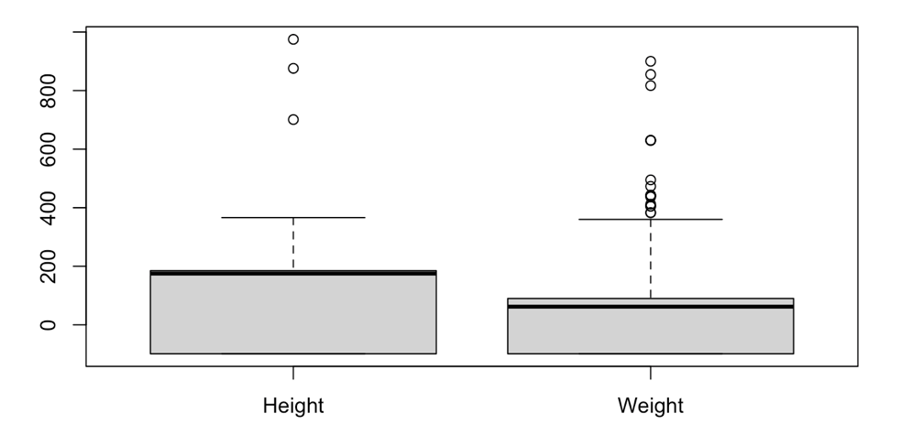
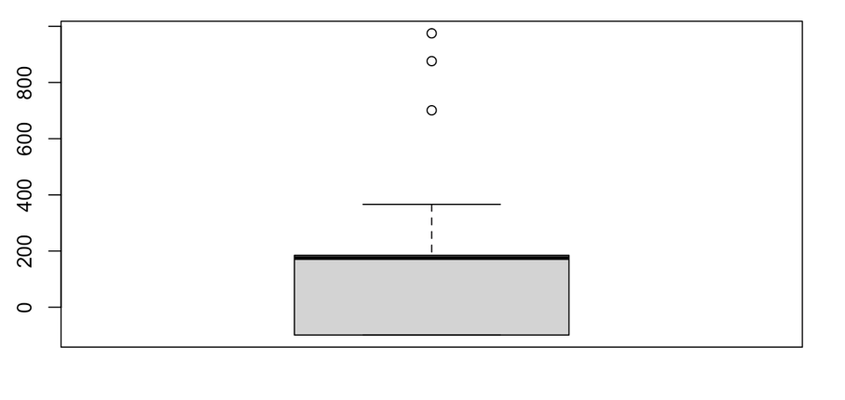
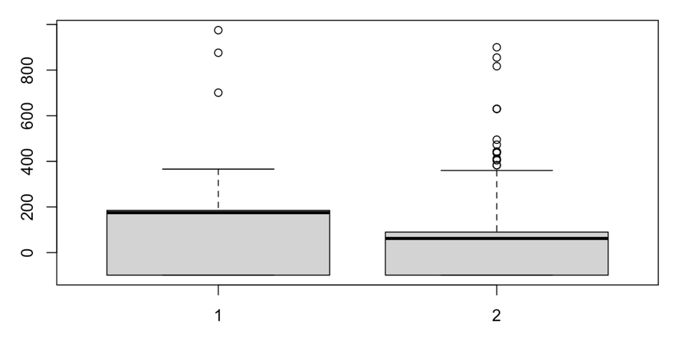
Basic R plotting: boxplots
Session 1.5
boxplot(heroes$Height)
boxplot(heroes$Height, heroes$Weight)
boxplot(heroes$Height,heroes$Weight, names=c("Height", "Weight"))

Slide 71
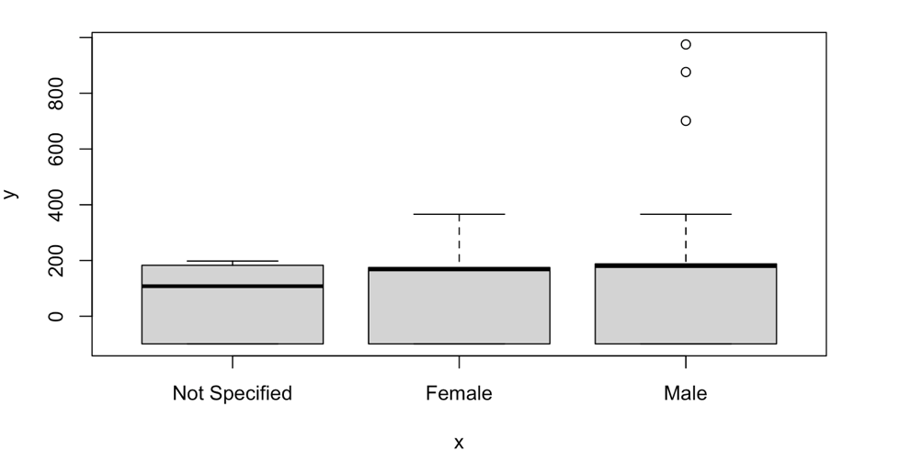
Basic R plotting: boxplots
Session 1.5
plot(heroes$Gender, heroes$Height)

Slide 72

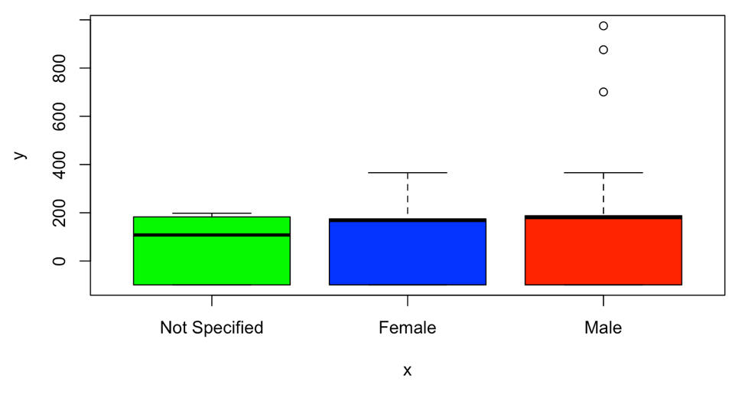
Basic R plotting: boxplots
Session 1.5
plot(heroes$Gender, heroes$Height, col=c("green","blue", "red"))

Slide 73
Basic R plotting: add legend()
Session 1.5
plot(heroes$Height, heroes$Weight, col=heroes$Gender, pch=24, cex=2)

Slide 74
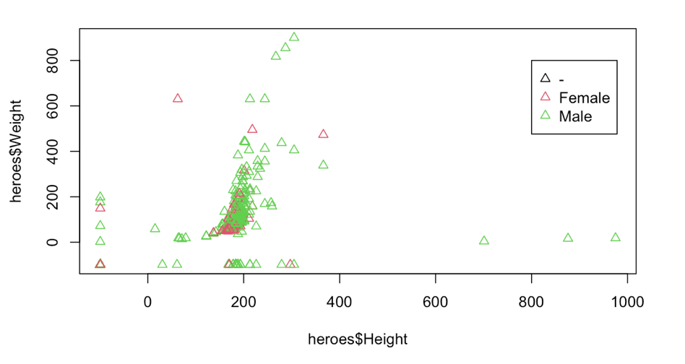
Basic R plotting: add legend()
Session 1.5
plot(heroes$Height, heroes$Weight, col=heroes$Gender, pch=24, cex=2)
legend(x=800, y=800, legend = levels(heroes$Gender), col=c(1:3), pch= 24)

Slide 75
How to visualize plots
Session 1.5
Directly in Rstudio
For quick visualization and exploratory analysis
Depending on type of file used can be seen in the output directly on the source pane (Rmarkdown) or in the output window.
Export and save as pdf, png...
Functions pdf(), png(), bmp(), jpeg()
dev.off

Slide 76
Basic R plotting: help
Session 1.5
help() / ?
The R Graph Gallery
If you don’t know something: google it!

Slide 77
Let´s practice!
Session 1.5
Plotting exercise
Image by lucabravo on Freepik

Slide 78
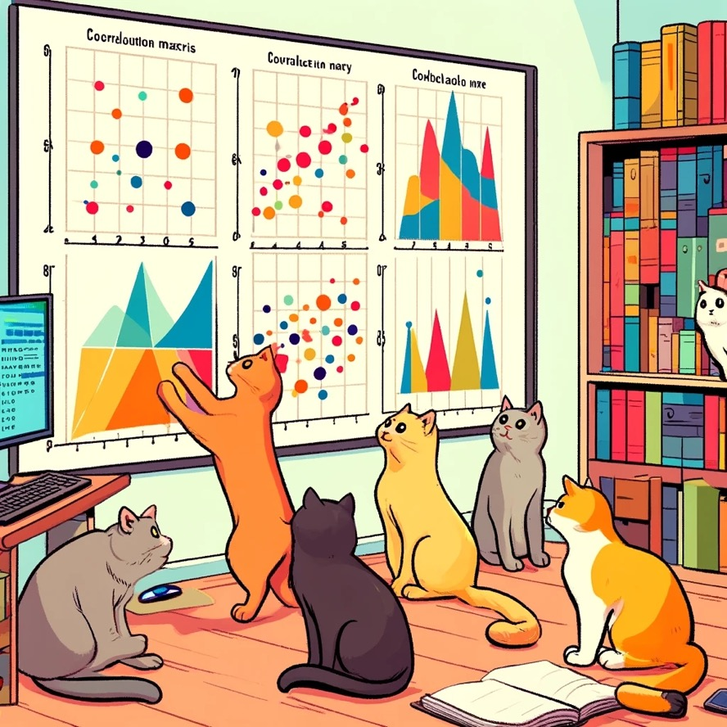
choose your own adventure!

